Slide 1
INTRODUCTION TO NEURAL NETWORKS
Dr. A. Anitha
Professor Grade -1
School of Computer Science Engineering and Information Systems
Vellore Institute of Technology
Vellore – 632014
Ph: 9994687528
Mail id: aanitha@vit.ac.in

Slide 2
NEURAL NETWORKS
A neural network is a processing device
It is either an algorithm or an actual hardware
Its design is inspired by the design and functioning of animal brains and components thereof
It has the ability to learn by example
It has made them very flexible and powerful
The networks are also well suited for real-time systems
They have fast response and less computational times
They have a parallel architecture

Slide 3
HUMAN BRAIN
An amazing processor
Its exact working is still a mystery
Basic elements are specific type of cells, known as neurons
Neurons do not regenerate (grow after loss or damage)
Neurons provide us with abilities to
Remember
Think and
Apply previous experiences to our every action
Human brain comprises of about 100 billion neurons (10^11)
Each neuron is connected to 200,000 other neurons
Power of human mind comes from # Neurons and their multiple interconnections

Slide 4
WHY NEURAL NETWORKS?
Have you ever wondered why there are tasks that are dead simple for any human but incredibly difficult for computers?
Artificial neural networks (ANN)were inspired by the central nervous system of humans.
Like their biological counterpart, ANN’s are built upon simple signal processing elements (Called artificial neurons) that are connected together into a large mesh

Slide 5
WHAT CAN NEURAL NETWORKS DO?
ANN’s have been successfully applied to a number of problem domains:
Classify data by recognizing patterns.
Is this a tree on that picture?
Detect anomalies or novelties, when test data does not match the usual patterns.
Is the truck driver at the risk of falling asleep?
Are these seismic events showing normal ground motion or a big earthquake?
Process signals, for example, by filtering, separating, or compressing.
Approximate a target function–useful for predictions and forecasting.
Will this storm turn into a tornado?

Slide 6
ARTIFICIAL NEURAL NETWORKS (ANN)
Artificial Neural Networks are information processing systems
Constructed and implemented to model the human brain
The main objective of the neural network research is:
To develop a computational device for modeling the brain
To perform various computational tasks at a faster rate than the traditional systems

Slide 7
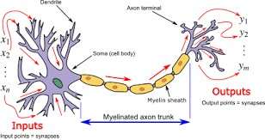
Schematic diagram for a biological neuron

Slide 8
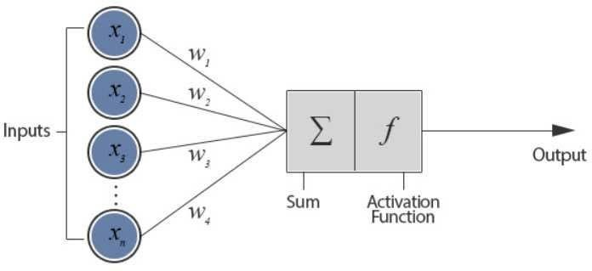
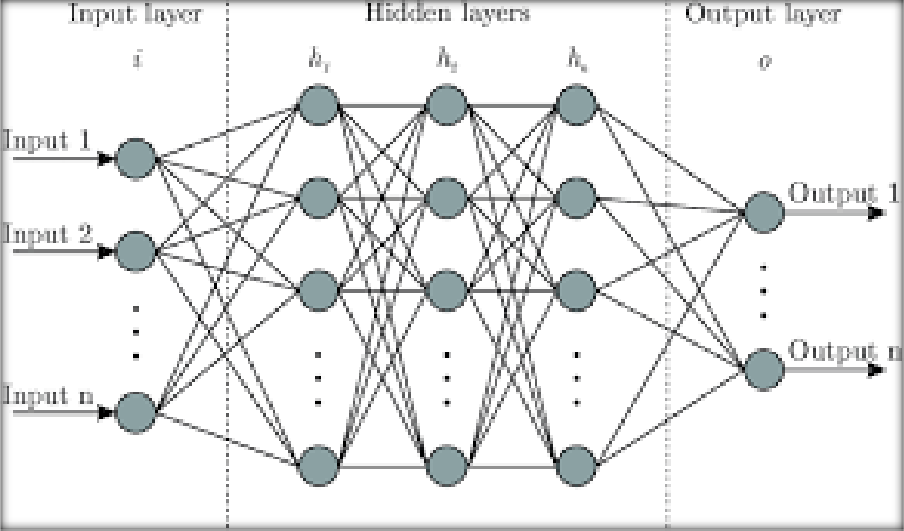
Architecture of Simple Artificial Neuron net

Slide 9
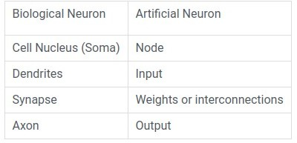
Biological vs. Artificial Neuron

Slide 10
Artificial Neuron
The artificial neuron has the following characteristics:
A neuron is a mathematical function modeled on the working of biological neurons
It is an elementary unit in an artificial neural network
One or more inputs are separately weighted
Inputs are summed and passed through a nonlinear function to produce output
Every neuron holds an internal state called activation signal
Each connection link carries information about the input signal
Every neuron is connected to another neuron via connection link

Slide 11
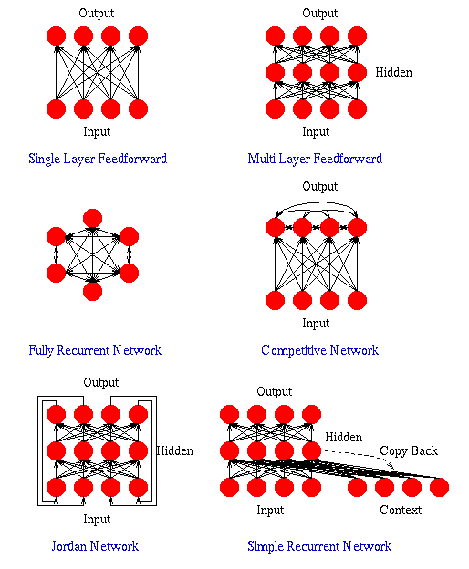

Slide 12
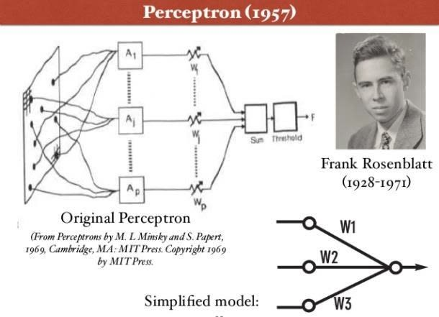
Perceptron
•
A perceptron is a neural network unit (an artificial neuron) that does certain computations to detect features or business intelligence in the input data.

Slide 13
Perceptron
Perceptron was introduced by Frank Rosenblatt in 1957.
He proposed a Perceptron learning rule based on the original MCP neuron.
A Perceptron is an algorithm for supervised learning of binary classifiers.
This algorithm enables neurons to learn and processes elements in the training set one at a time.

Slide 14
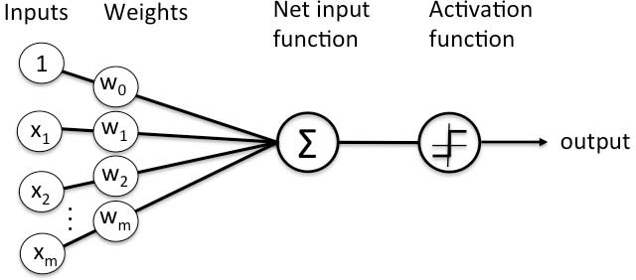
Perceptron

Slide 15
Perceptron
There are two types of Perceptrons: Single layer and Multilayer.
Single layer Perceptrons can learn only linearly separable patterns.
Multilayer Perceptrons or feedforward neural networks with two or more layers have the greater processing power.
The Perceptron algorithm learns the weights for the input signals in order to draw a linear decision boundary.
This enables you to distinguish between the two linearly separable classes +1 and -1.
Note: Supervised Learning is a type of Machine Learning used to learn models from labeled training data. It enables output prediction for future or unseen data.

Slide 16
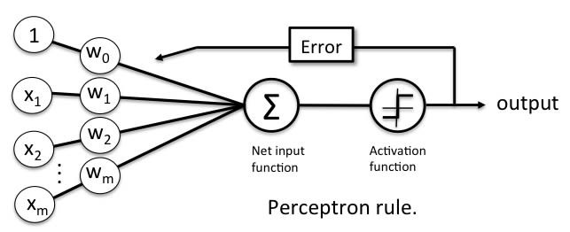
Perceptron Learning Rule
Perceptron Learning Rule states that the algorithm would automatically learn the optimal weight coefficients.
The input features are then multiplied with these weights to determine if a neuron fires or not.
•
•

Slide 17

Perceptron function
Perceptron is a function that maps its input “x,” which is multiplied with the learned weight coefficient; an output value ”f(x)”is generated.
In the equation given above:
“w” = vector of real-valued weights
“b” = bias (an element that adjusts the boundary away from origin without any dependence on the input value)
“x” = vector of input x values

Slide 18

Perceptron function
“m” = number of inputs to the Perceptron
The output can be represented as “1” or “0.” It can also be represented as “1” or “-1” depending on which activation function is used.

Slide 19
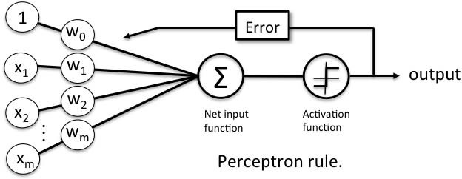
Inputs of Perceptron
•
A Perceptron accepts inputs, moderates them with certain weight values, then applies the transformation function to output the final result. The above below shows a Perceptron with a Boolean output.

Slide 20
Inputs of Perceptron
•
A Boolean output is based on inputs such as salaried, married, age, past credit profile, etc. It has only two values: Yes and No or True and False.
The summation function “∑” multiplies all inputs of “x” by weights “w” and then adds them up as follows:
•

Slide 21
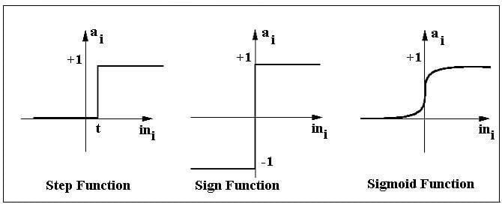
Activation function
•
The activation function applies a step rule (convert the numerical output into +1 or -1) to check if the output of the weighting function is greater than zero or not.

Slide 22
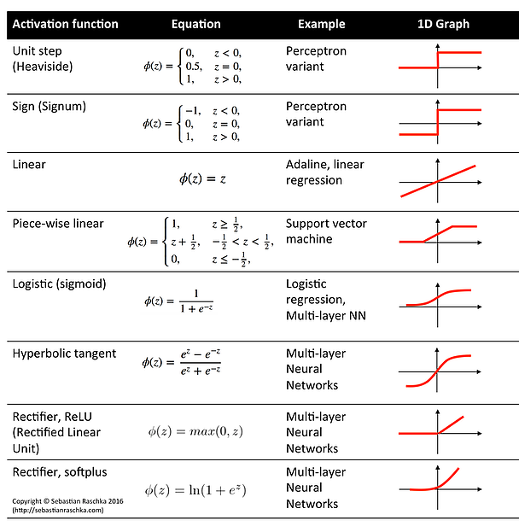
Activation Functions

Slide 23
Example
•
For example:
If ∑ wixi> 0 => then final output “o” = 1 (issue bank loan)
Else, final output “o” = -1 (deny bank loan)
•
Step function gets triggered above a certain value of the neuron output; else it outputs zero. Sign Function outputs
+1 or -1 depending on whether neuron output is greater than zero or not. Sigmoid is the S-curve and outputs a value between 0 and 1.

Slide 24

Output of Perceptron
•
Perceptron with a Boolean output:
•
Inputs: x1…xn
•
Output: o(x1….xn)
•
Weights: wi=> contribution of input xi to the Perceptron output;
w0=> bias or threshold

Slide 25
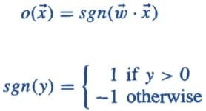
Output of Perceptron
•
If ∑w.x > 0, output is +1, else -1. The neuron gets triggered only when weighted input reaches a certain threshold value.
•
An output of +1 specifies that the neuron is triggered. An output of -1 specifies that the neuron did not get triggered.
“sgn” stands for sign function with output +1 or -1.
•

Slide 26
Error in Perceptron
In the Perceptron Learning Rule, the predicted output is compared with the known output.
If it does not match, the error is propagated backward to allow weight adjustment to happen.

Slide 27
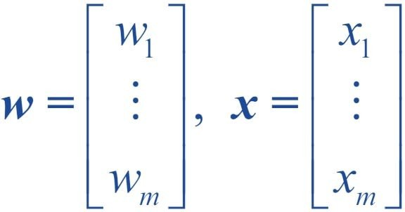
Perceptron decision function
•
A decision function φ(z) of Perceptron is defined to take a linear combination of x and w vectors.

Slide 28

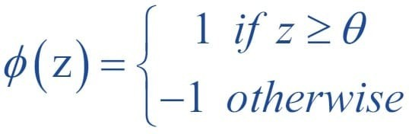
Perceptron: Decision Function
•
The value z in the decision function is given by:
•
The decision function is +1 if z is greater than a threshold θ, and it is -1 otherwise.
•
This is the Perceptron algorithm.

Slide 29
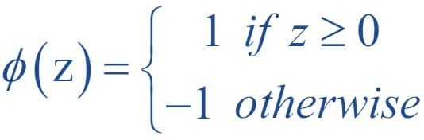
Bias Unit
•
For simplicity, the threshold θ can be brought to the left and represented as w0x0, where w0= -θ and x0= 1.
•
The value w0 is called the bias unit.
•
The decision function then becomes:

Slide 30
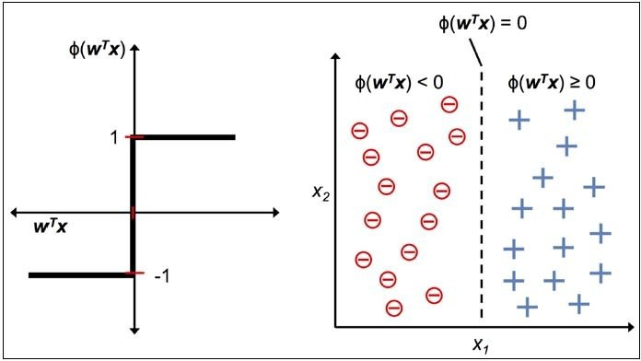
Output
The figure shows how the decision function squashes wTx to either +1 or -1 and how it can be used to discriminate between two linearly separable classes.

Slide 31
Perceptron at a Glance
•
Perceptron has the following characteristics:
Perceptron is an algorithm for Supervised Learning of single layer binary linear classifier.
– Optimal weight coefficients are automatically learned.
Weights are multiplied with the input features and decision is made if the neuron is fired or not.
Activation function applies a step rule to check if the output of the weighting function is greater than zero.
Linear decision boundary is drawn enabling the distinction between the two linearly separable classes +1 and -1.
If the sum of the input signals exceeds a certain threshold, it outputs a signal; otherwise, there is no output.

Slide 32
Single Layer perceptron Example
Consider a single perceptron with Sign activation function. The perceptron is represented by weight vector [ 0.4 -0.3 0.1]t and bias =0, if the input vector to the perceptron is X=‘0,2 0.6 0.5] then the output is ??

Slide 33
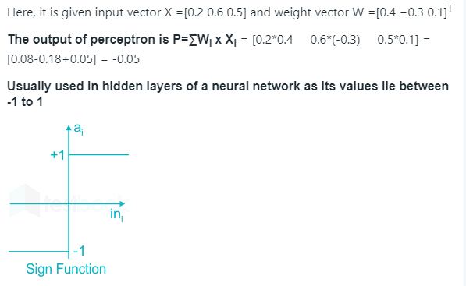
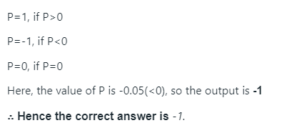
Solution

Slide 34
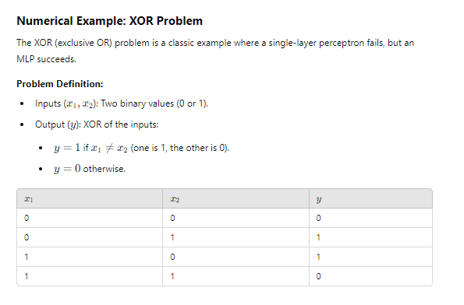
Example for MLP

Slide 35
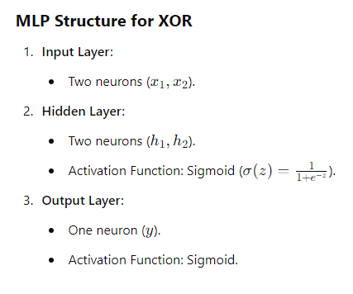

Slide 36
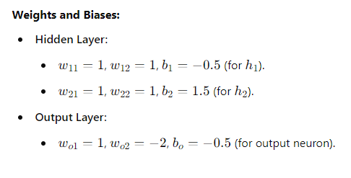

Slide 37
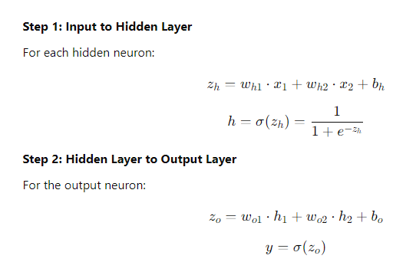

Slide 38
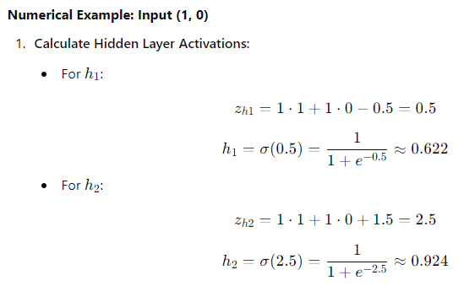

Slide 39
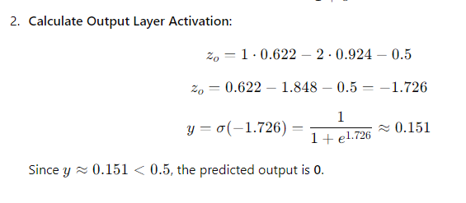
Try with step activation function (y=0, if the value is negative (z<0) and y=1, if the value is positive (z>0) and check the output for the same above input.

Slide 40
